Slide 1
Evidence of the Theory of Evolution
Biogeography
Comparative Anatomy
Comparative Embryology
Comparative Genomics
Comparative Biochemistry
Phylogenetic Trees

Slide 2
Evolution
Mutation
Non-random changes to allele frequency of population
Random changes to allele frequency of population
Variation in Gene Pool
Variation in Populations
Natural Selection
Sexual Selection
Artificial Selection (Selective breeding)
Genetic Drift
Bottleneck Effect
Founder Effect
Mechanisms of Evolution
Microevolution
Gene Flow

Slide 3
Evolution
1. Mutation
2. Natural Selection
3. Genetic Drift
Mechanisms of Evolution
4. Gene Flow
Microevolution
Long time period (many generations)
Speciation
Macroevolution

Slide 4
Syllabus:
Evidence for the theory of evolution includes: comparative genomics (molecular evidence), the fossil record, comparative anatomy and embryology
Use examples to explain how comparative genomics and biochemistry, comparative anatomy and embryology provide evidence for the theory of evolution
Heredity
Essential
Question:
BIOLOGY WA UNITS 3&4
Chapter 8 Mechanisms of Evolution and Speciation pg. 310 – 316
Questions
Set 8.5 pg.275 Q 1-7
Set 8.3 pg.260-261 Q 1-6
See PPT
BIOZONE Activity Number:
  226 Homologous Structures
  240 Patterns of Evolution
  226
  227
  240
  241
  242
  243
  224 – DNA hybridisation
  225
  233
  229
  231

Slide 5
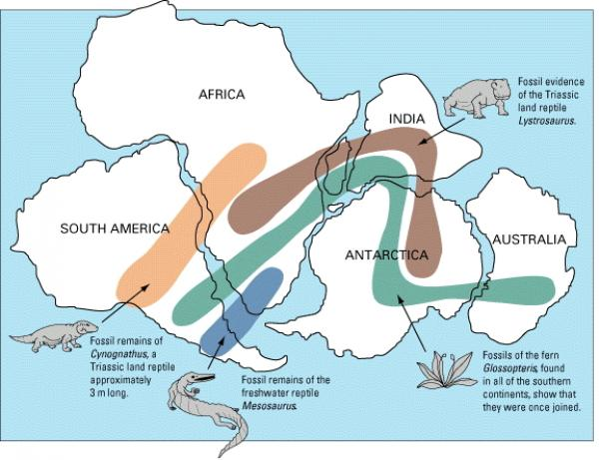
Topic Question 1: Explain, using an example, how Biogeography can help scientists understand the distribution of species across different continents
Define Biogeography
Biogeography is the study of the distribution of organisms and ecosystems across the world and through geologic time.
Evidence of evolution
The fauna and flora of Australia owe their uniqueness to the isolation of the landmass.
However, Australia and other landmasses in the southern hemisphere share many plant and animal groups.
By looking at the pattern of these distributions today, plus that of the fossils, we are able to reconstruct Australia’s evolutionary history.
Example of Biogeography providing evidence of evolution
Southern beech trees, Nothofagus, are found as both living and fossil specimens in mainland Australia, Tasmania, Papua New Guinea, New Caledonia, New Zealand, Antarctica and South America.
The far-flung distribution of Nothofagus provides evidence that Gondwana once existed.

Slide 6
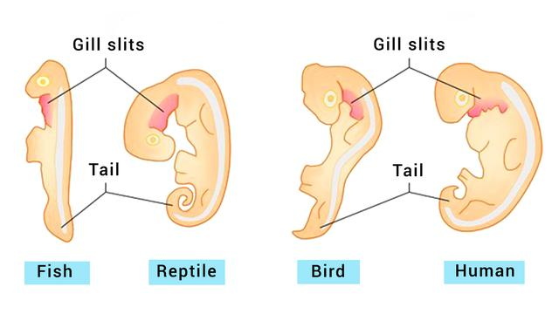
Topic Question 2:
define Comparative embryology?
All members of the phylum Chordata (Vertebrates) have, at some stage of their development:
a dorsal notochord (a solid tissue running along the back),
pharyngeal slits (which turn into gill slits in fish),
a dorsal nerve cord
a tail that extends past the anus.
The embryos of the different vertebrates are very similar and show features that are not present in adults.
This suggests that these vertebrates evolved from a common aquatic ancestor, such as the crossopterygian fish.
Topic Question 3:
Using examples, explain how is Comparative embryology provides evidence for the theory of evolution

Slide 7
Topic Question 4:
Define comparative anatomy
Topic Question 5:
Define Homologous structures
Topic Question 6:
explain how is Comparative anatomy provides evidence for the theory of evolution

Slide 8
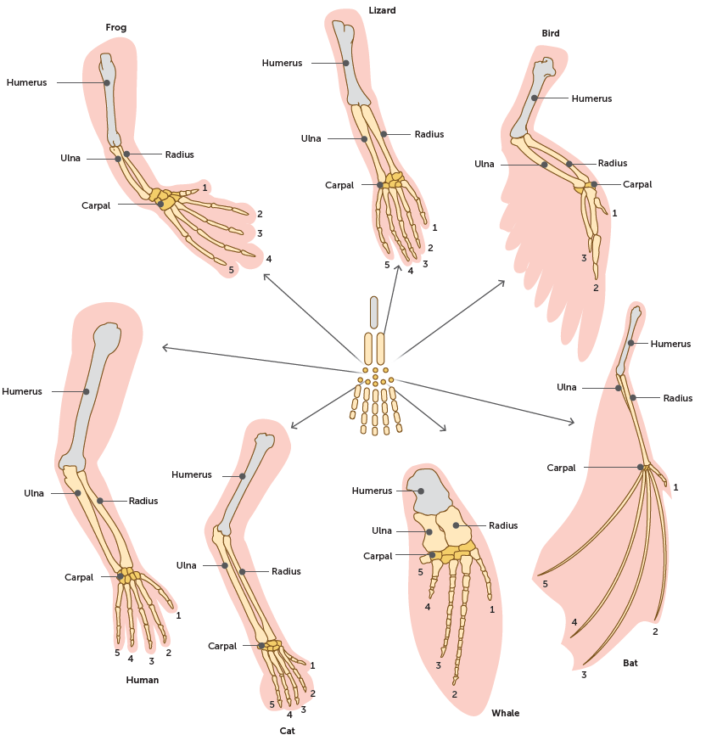
Topic Question 7: Describe examples of Comparative anatomy and explain how they provide evidence of evolution
For each animal, indicate what type of movement the limb is responsible for
Animal | Primary Function
Human | Using tools, grasping and holding objects
Frog
Lizard
Bird
Bat
Whale
Cat

Slide 9
Topic Question 7: Describe examples of Comparative anatomy and explain how they provide evidence of evolution
Compare the skeletal structure of each limb to the human arm. Relate the differences you see in form to the differences in function
Animal | Comparison to Human forearm in form | Comparison to Human Arm in function
Frog
Lizard
Bird
Bat
Whale | Whale has a much shorter & thicker humerus, radius & ulna. Much longer metacarpals. Thumb has been shortened to a stub | The whale fin needs to be longer to help in movement through water. Thumbs are not necessary as fiins are not used for grasping
Cat

Slide 10
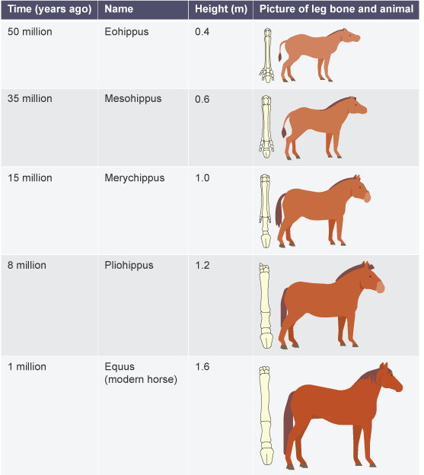
Topic Question 7: Describe examples of Comparative anatomy and explain how they provide evidence of evolution
The pentadactyl limb seen in the horse provides an excellent example of how evolution has happened.
As the marshy ground became drier, horses with smaller feet were generally faster. They had an evolutionary advantage because they were able to avoid predators.
Over many, many generations horse's feet have evolved to be smaller and the horses themselves taller and stronger.

Slide 11
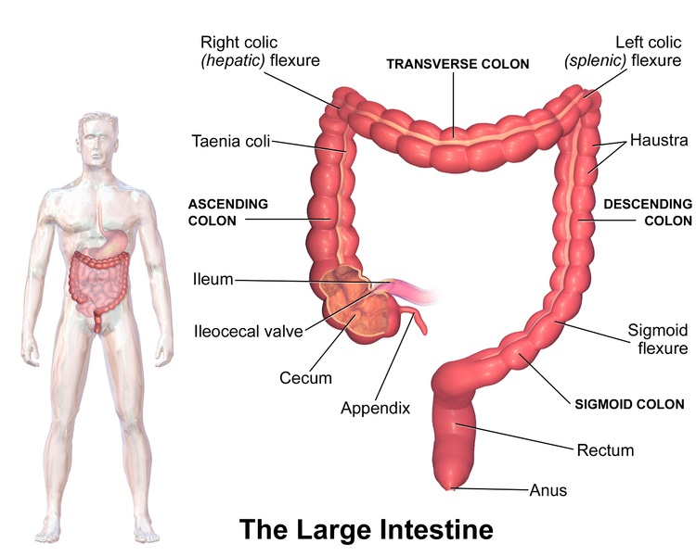
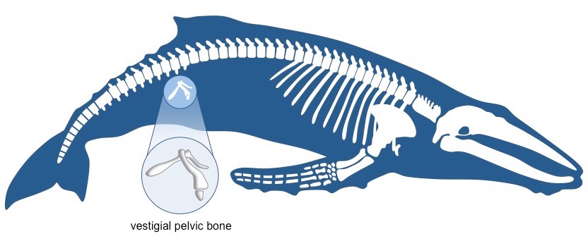
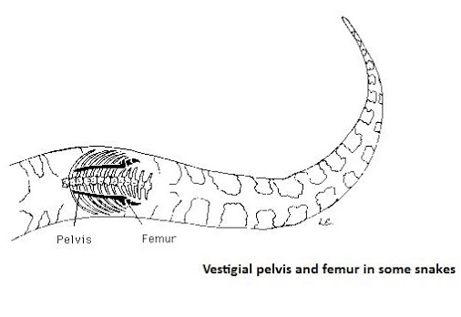
Topic Question 7: Describe examples of Comparative anatomy and explain how they provide evidence of evolution
In some cases, homologous structures stemming from a common descent can eventually cease to have any functional use for an organism; the structure may not necessarily impede a particular adaptation of an organism, but at the same time the structure no longer serves a ‘useful’ purpose.
These structures are called vestigial structures.
Vestigial structures can take a variety of forms, including bones, soft tissues, organs, cells or molecules.
Vestigial organs are evidence for evolution, because it is hypothesised that they were once present and functional in their ancestors. Changes in the environment have rendered these organs redundant, so over time they have lost their functionality.
They demonstrate the evolutionary divergence of a species from a past behaviour or activity.

Slide 12
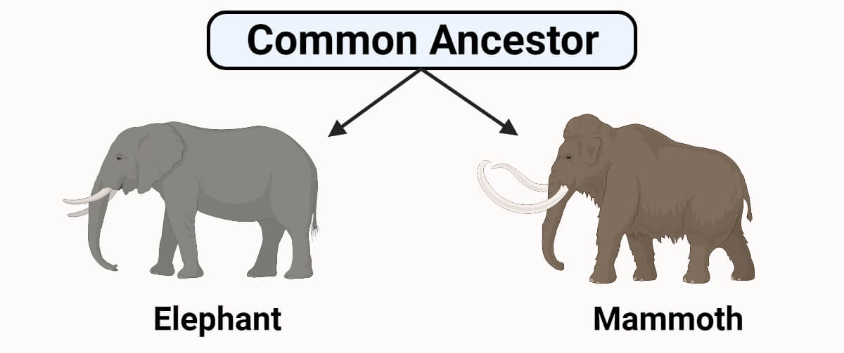
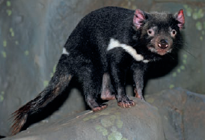
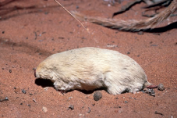
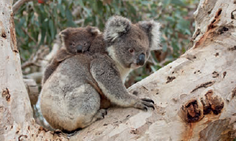
Recap: Define divergent evolution & provide examples of divergent evolution
Divergent evolution is a pattern of evolution in which differences between groups of organisms accumulate to a critical point that leads to speciation, the development of a new species.
This pattern is usually the result of the dispersal of a single species to different environments; that is, groups from the same species become isolated from one another, stopping gene flow.
The sub-populations are subjected to different environmental pressures, suited to certain structures that can perform functions specific to surviving their unique environment.
Homologous structures indicate divergent evolution, because new species will have the same fundamental structural plan, but the structures may be used in different ways.
Recap: Define adaptive radiation

Slide 13
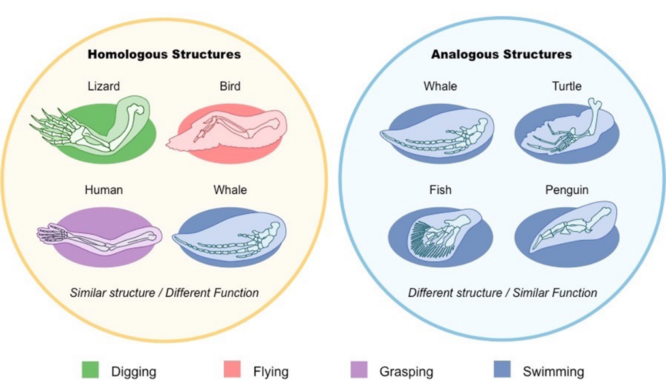
Topic Question 8: Using examples, explain how Analogous structures provides evidence for convergent evolution
Example of Analogous Structures
The eyes of octopuses and vertebrates are remarkably similar, even down to fine points of detail.
However, in the vertebrate eye, the nerve fibres lie in front of the sensory cells of the retina, whereas in the octopus eye they lie behind them.
Because of this, the vertebrate eye has a blind spot where the optic nerve emerges from it, whereas the octopus eye lacks one.
The reason for this difference lies in the ways the two eyes developed, which indicates that they are the products of two distinct lines of evolution.

Slide 14
Topic Question 8: Using examples, explain how Analogous structures provides evidence for convergent evolution
Example of Analogous Structures
The eyes of octopuses and vertebrates are remarkably similar, even down to fine points of detail.
However, in the vertebrate eye, the nerve fibres lie in front of the sensory cells of the retina, whereas in the octopus eye they lie behind them.
Because of this, the vertebrate eye has a blind spot where the optic nerve emerges from it, whereas the octopus eye lacks one.
The reason for this difference lies in the ways the two eyes developed, which indicates that they are the products of two distinct lines of evolution.

Slide 15
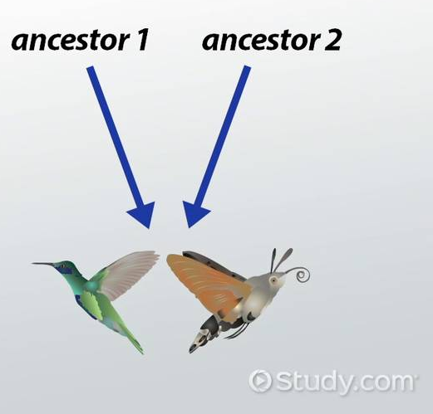
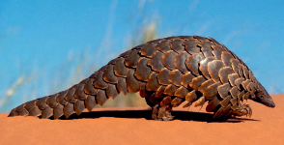
Topic Question 9: Define convergent evolution & provide examples of convergent evolution
Convergent evolution is a pattern that occurs when unrelated organisms evolve similar adaptations in response to their environment.
The results of convergent evolution often show up as analogous structures: adaptations of very different types of structures that solve a problem in a similar way.
The structures are genetically relatively different, but their functionality is very similar.
Modern anteaters include echidnas (monotremes), numbats (marsupials), and pangolins (placentals). All of these species have an elongated snout that functions as a smelling and digging device, and a long, extendible tongue that can extract ants from crevices.
Analogous structures such as elongated snouts, are similar due to environmental pressures, not because they share a recent common ancestor. Instead, they would share a very distant common ancestor.

Slide 16
Topic Question 10: define the terms, genomics, relatedness and comparative genomics
Term | Definition
 | is the study of the whole set of genes of a species and the interactions of the genes within a genome. The genomes of many species have been fully sequenced. Complete genomes are now available for humans, chimpanzees, koalas and bacteria, among others.
 | is a measure of evolutionary distance. The relatedness of groups of organisms is reflected in the similarity of their DNA sequences. Two species are more related if they have a more recent common ancestor and less related if they have a less recent common ancestor
 | is a field of biological research in which researchers use a variety of tools to compare the entire genome sequences of different species. The more similar in sequence the genes and genomes of two species are, the more closely related those species are.

Slide 17
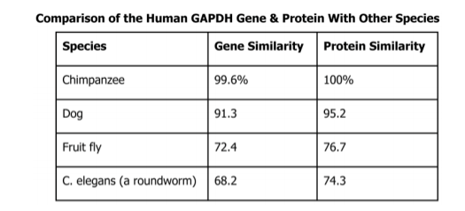
Topic Question 11: Using examples, explain how is Comparative genomics provides evidence for the theory of evolution

Slide 18
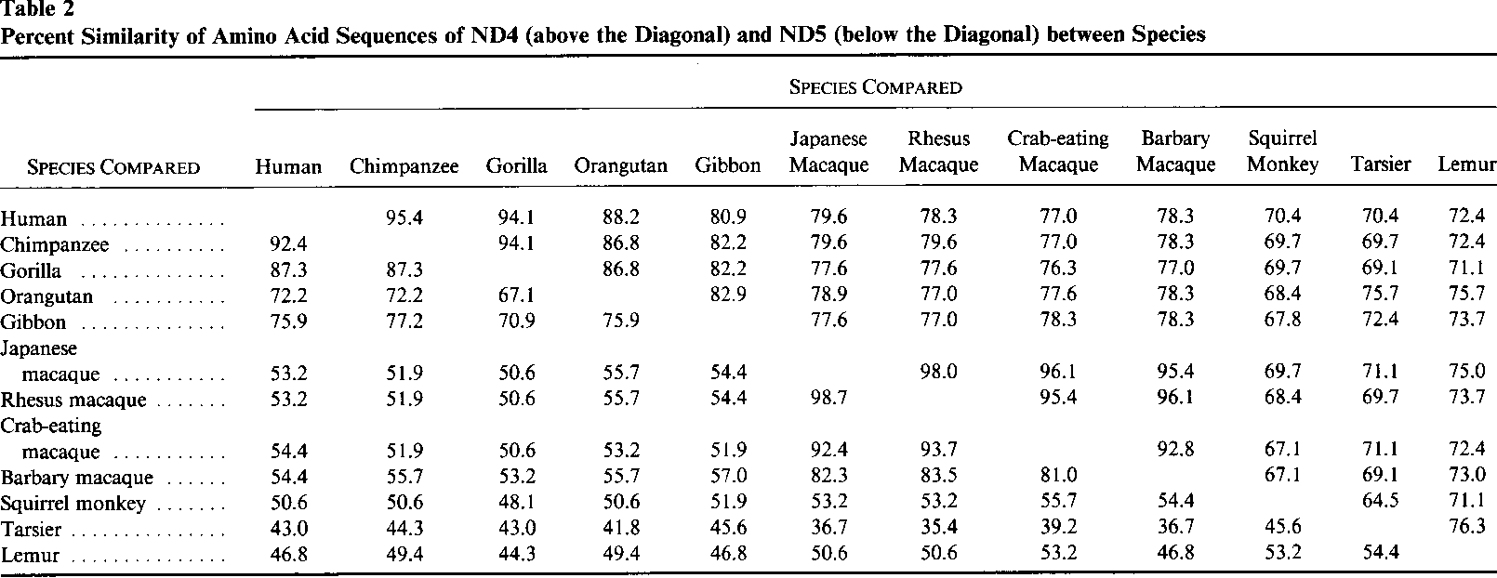
Topic Question 12: Using examples, explain how is Comparative Biochemistry provides evidence for the theory of evolution
Primate | No. of differences in amino acid sequence
Chimpanzee | 0
Gorilla | 1
Gibbon | 3
Orangutan | 4
Macaque (monkey) | 8
Lemur | 5

Slide 19
Practice question

Slide 20
Practice question

Slide 21
Heredity
Syllabus:
Technological developments in the fields of comparative genomics, comparative biochemistry and bioinformatics have enabled identification of further evidence for evolutionary relationships (SHE)
Developments in bioinformatics DNA sequencing technology are allowing biologists to use comparative genomics and biochemistry to develop an in-depth understanding of evolution
Essential
Question:
BIOLOGY WA UNITS 3&4
Read
Chapter 8 Mechanisms of Evolution and Speciation pg. 262 - 268
Questions
See PPT
BIOZONE Activity Number:
See PPT

Slide 22
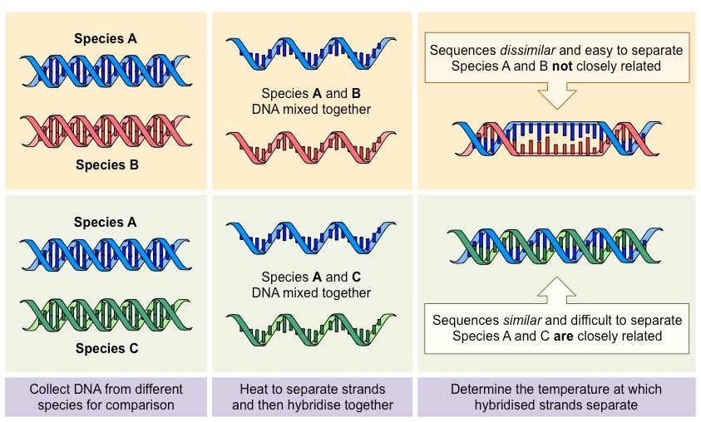
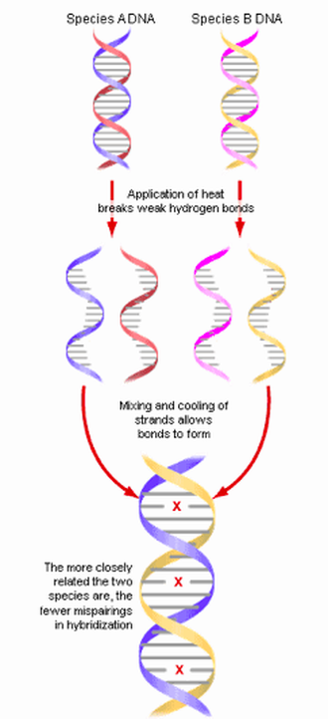
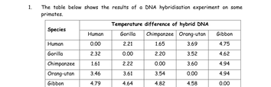
Topic Question 1: describe how dna hybridisation is used to provide evidence of evolution
Based on the table above, which species are most closely related to humans and why?

Slide 23
Topic Question 2:
define bioinformatics
Topic Question 4:
explain why bioinformatics is important in the field of comparative genomics

Slide 24
Heredity
Syllabus:
Evolutionary relationships between groups can be represented using phylogenetic trees
Draw and analyse a phylogenetic tree
Essential
Question:
BIOLOGY WA UNITS 3&4
Read
Chapter 8 Mechanisms of Evolution and Speciation pg. 262 - 268
Questions
BIOZONE Activity Number:

Slide 25

Topic Question 1:
describe what a phylogenetic tree is and what Does it Reveal about the evolutionary relationships between different species
Topic Question 3:
Label the parts of a phylogenetic tree

Slide 26
Topic Question 3: draw a phylogenetic tree

Slide 27
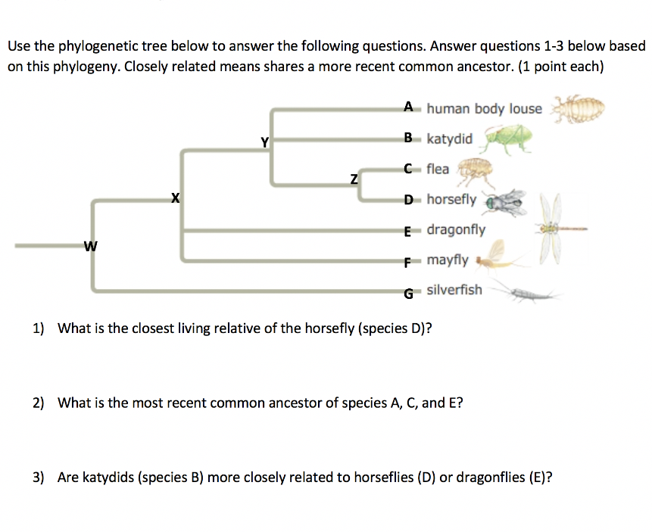
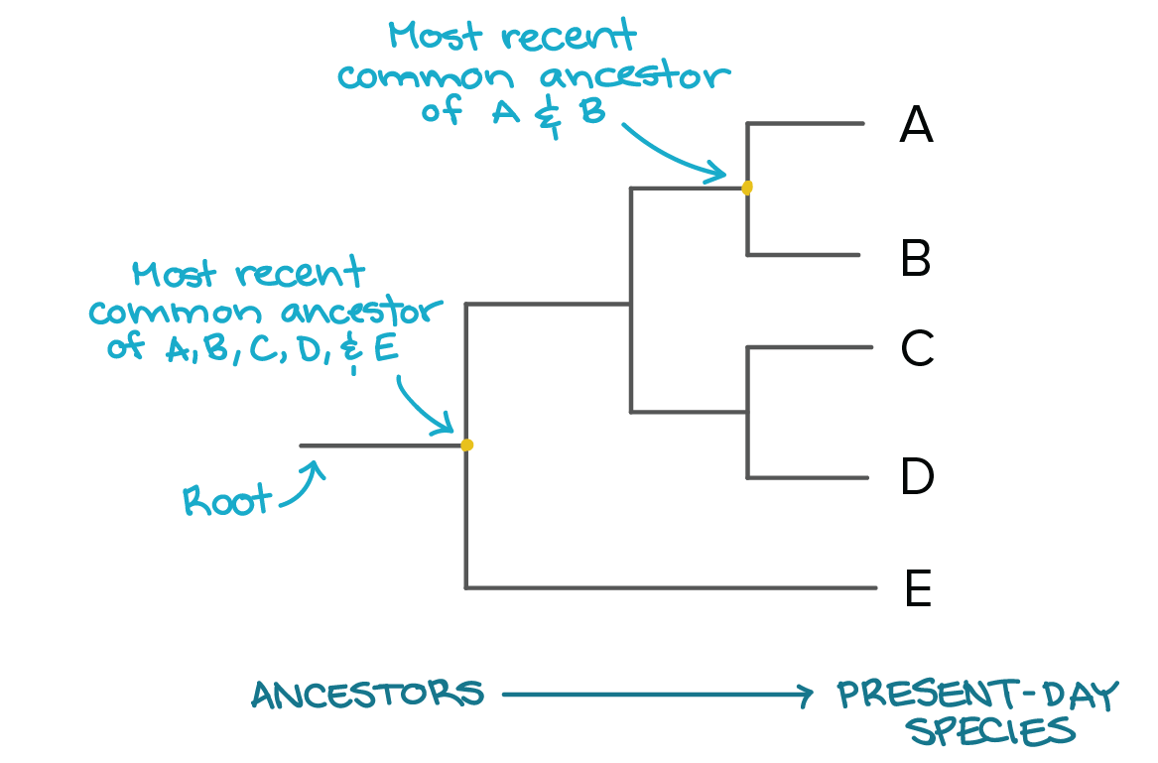
Topic Question 4: analyse a phylogenetic tree

Slide 28
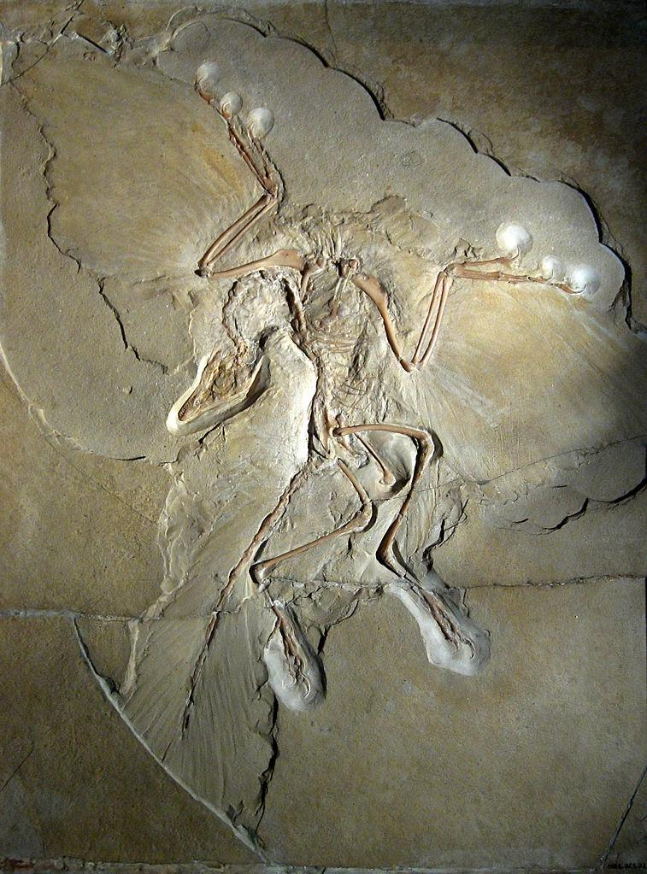
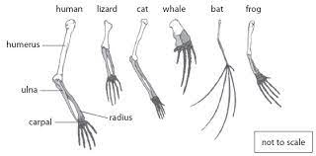
Sum it up!
Evidence of Evolution | Description of the evidence of evolution | Example of evidence of evolution
Fossils
Biogeography
Comparative Anatomy

Slide 29
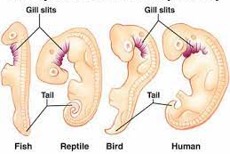
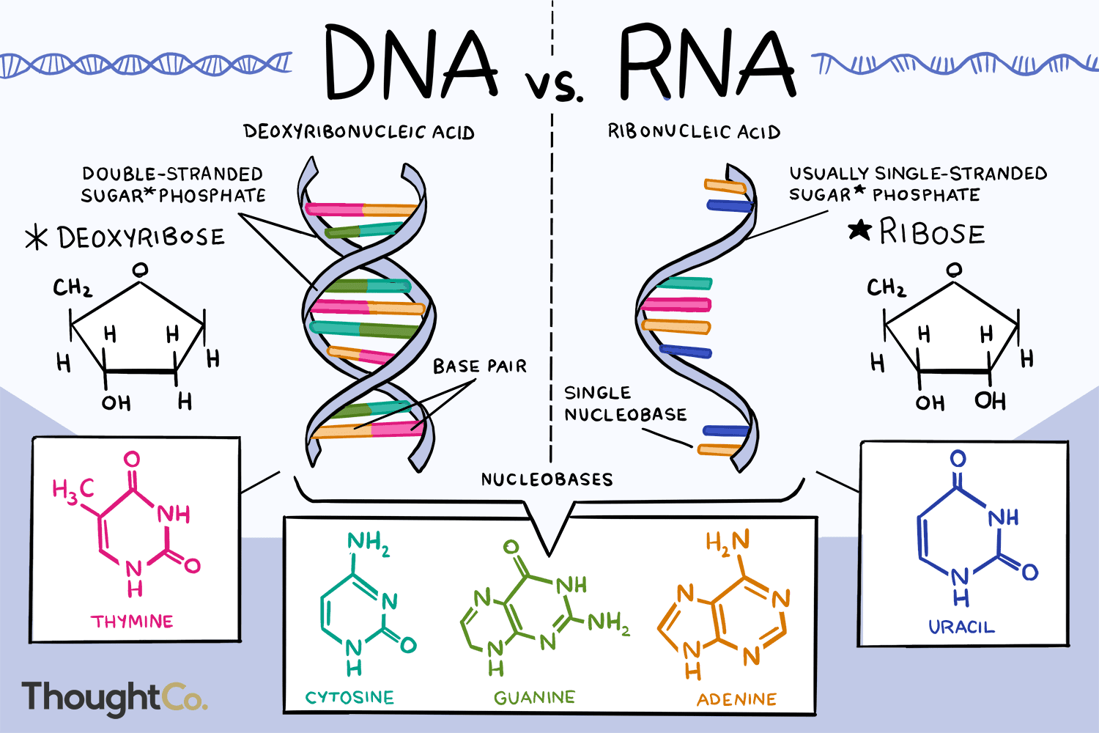
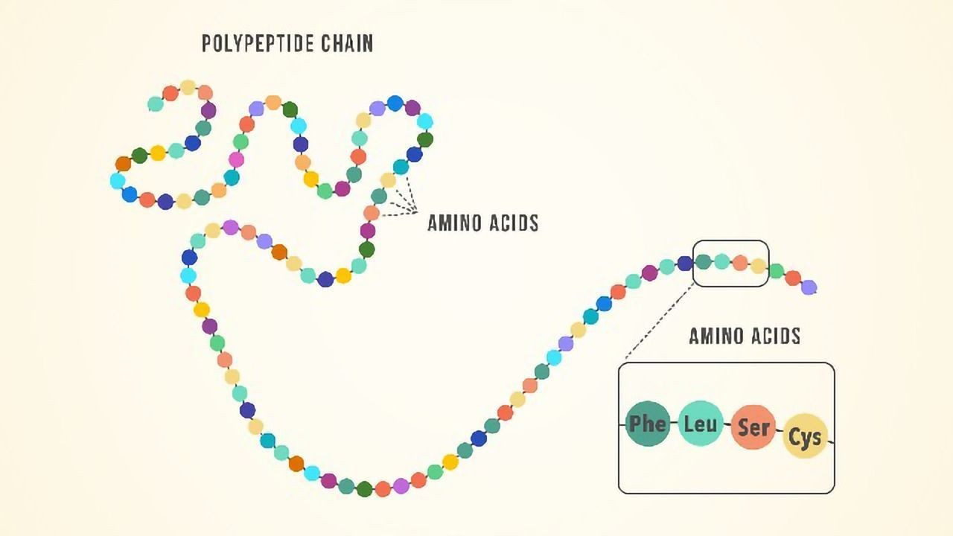
Sum it up!
Evidence of Evolution | Description of the evidence of evolution | Example of evidence of evolution
Comparative embryology
Comparative Genomics
Comparative Biochemistry

Slide 30
Practice Questions

